Slide 1

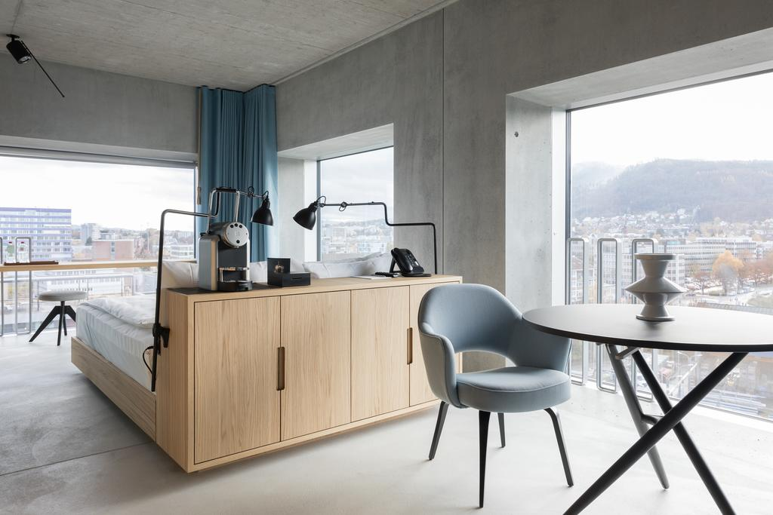
DROOMSY
TAILORMADE STAYS
TO WORK – RELAX – REFRESH IN PRIVACY
Room: Placid Hotel, Zürich
Notes:
Bild: Placid Hotel Zürich

Slide 2
D
R
BACKGROUND INFORMATION
DROOMSY IS A STARTUP THAT PATRICK IS WORKING ON
RENTING OUT HOTEL ROOMS FOR TAILORED SHORT STAYS
WE DIGITALIZED THE SHORT STAY BOOKING PROCESS

Slide 3
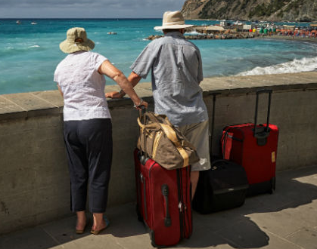
SAMPLE USE CASE
D
R
CHECK OUT
11 AM
DEPATRURE
6 PM
Doris & Peter BRIDGE INCONVENIENT TRAVEL ITINERARIES
Notes:
IT’S 11AM, THE SUN IS SHINING, THE WEATHER IS PLEASANT.
DORIS & PETER JUST CHECKED OUT FROM THEIR HOTEL. THEIR FLIGHT IS SCHEDULED FOR 6PM. THEY HAVE 5 HOURS LEFT BEFORE THEY NEED TO BE AT THE AIRPORT.
LATE CHECK-OUT WAS NOT AVAILABLE AT THEIR HOTEL. WHAT TO DO? SITTING IN A RESTAURANT WITH THEIR LUGGAGE FOR 5 HOURS IS NOT AN OPTION.
LUCKILY THEY FOUND A ROOM ON DROMSY TO BRDIDGE THE TIME BEFORE HEADING TO THE AIRPORT IN A HOTEL NEARBY.
THEY LOOK FORWARD TO ENJOY A LAST DAY AT THE BEACH AND THE POSSIBILITY TO CHANGE & REFRESH BEFORE DEPARTURE.

Slide 4
THE DAILY POTENTIAL
D
R
MOST HOTEL ROOMS ARE NOT USED THROUGHOUT THE DAY
Unsold Assets
Leisure Assets
10am
4pm
Business Assets
8am
6pm

Slide 5
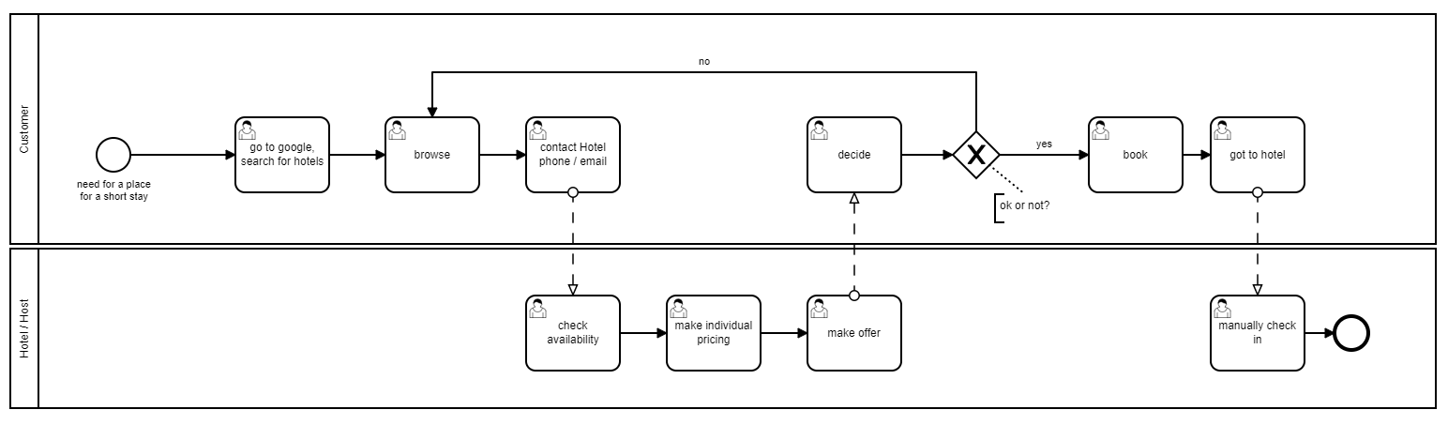
AS IS
D
R
Notes:
Short stays are not yet commonly used because every single case had to be dealt with individually resulting in high costs – likewise for guests and hosts.
Today there is no platform that one can access to find rooms nearby that can be booked on an hourly base. One would have to look up hotels online, call or email them or just walk by to ask if a room was available for a short stay use.
The hotels on their side have no process in place for such requests. They have to check in their systems and upon availability and willingness calculate a pricing and make an offer that the guest can either accept or decline
This manual process is painful for both guests and hosts and as a result its not commonly used

Slide 6
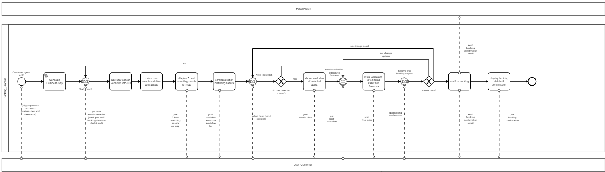
DIGITALIZED PROCESS
D
R
Notes:
By digitalizing the process starting with the listing of available options we make this offerings

Slide 7
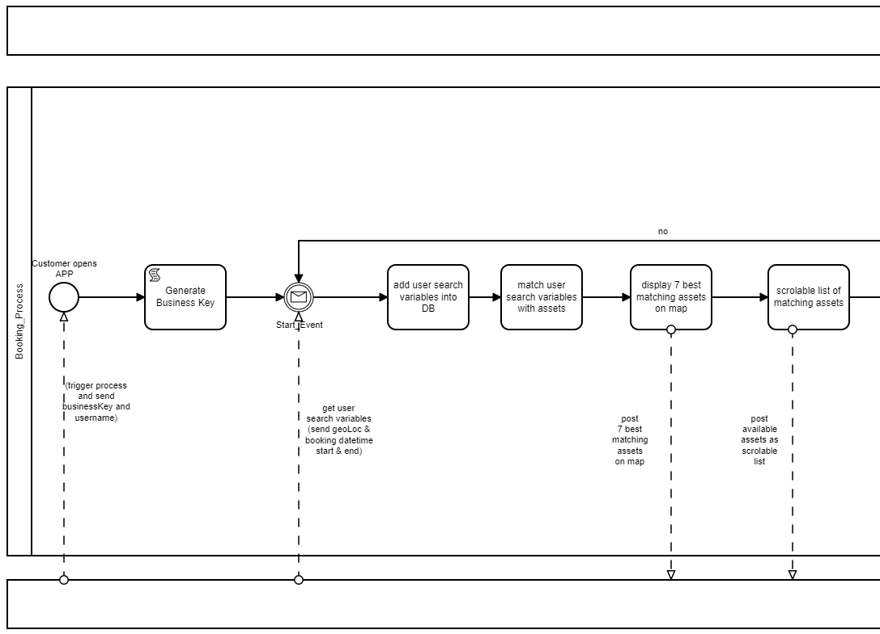

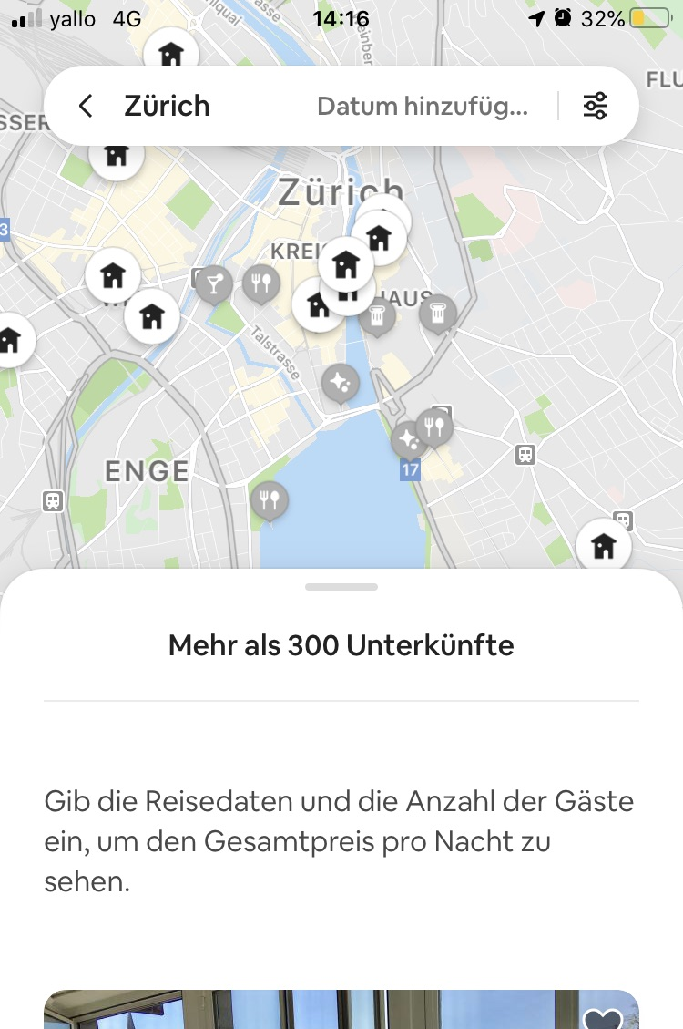
SEARCH FOR OPTIONS
D
R
SEARCH
1
HOST
SEARCH
BY PLACE…
NEAR BY
START (Date & Time)
END (Date & Time)
MANAGE MY BOOKINGS
GUEST

Slide 8
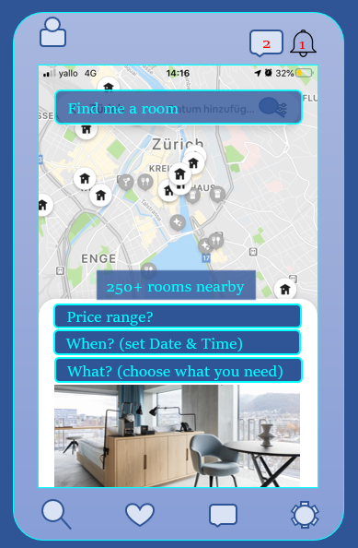
SEARCH FOR OPTIONS
D
R
DISPLAY OPTIONS
HOST
GUEST

Slide 9
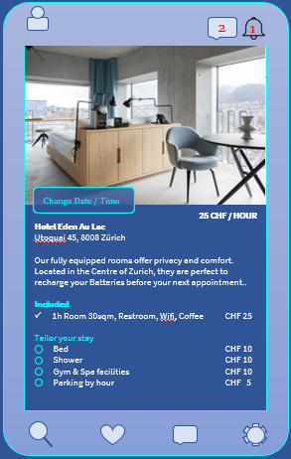
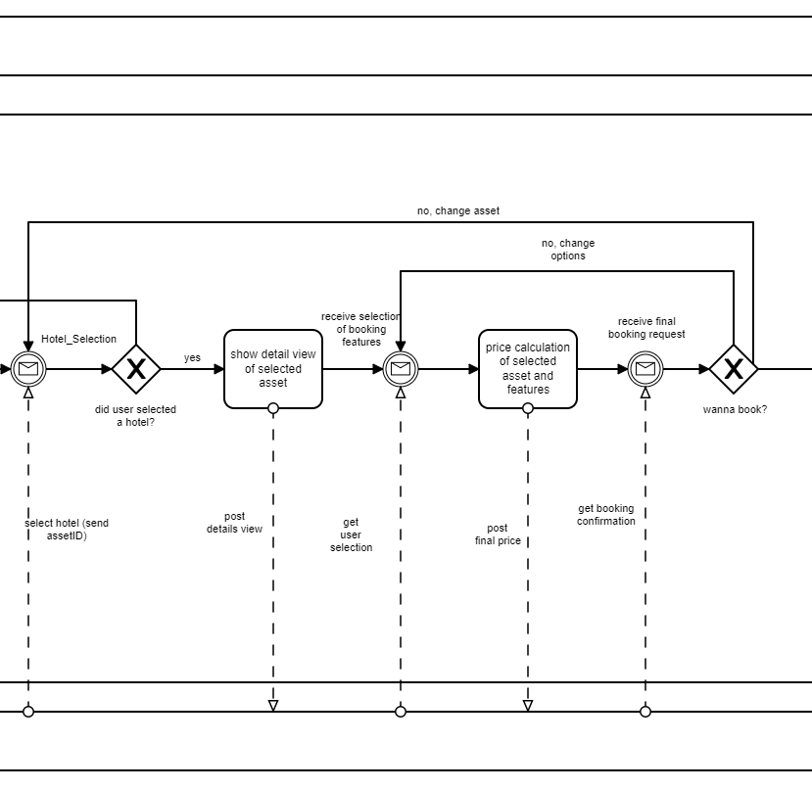
TAILOR YOUR STAY
D
R
SELECT FEATURES
HOST
GUEST

Slide 10
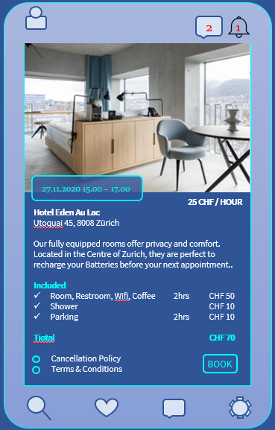
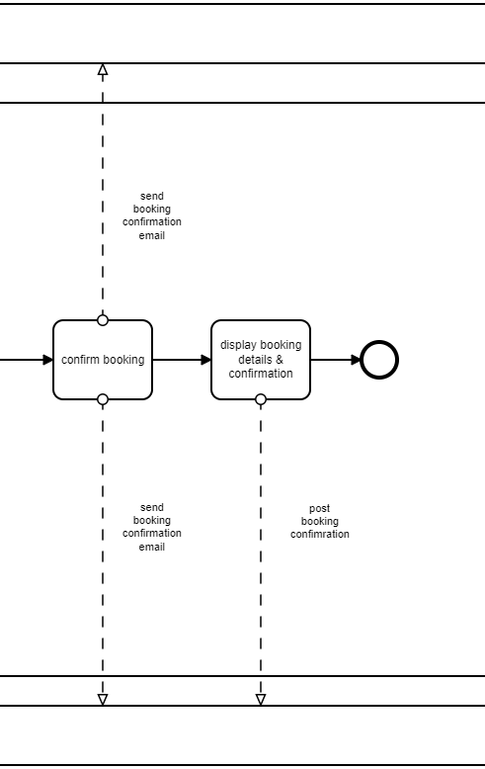
BOOK & HEAD TO HOTEL
D
R
BOOK ROOM
HOST
GUEST

Slide 11
DROOMSY HOURLY BOOKABLE ROOMS Find privacy whenever you need - wherever you go
Day rooms by hour
Only pay for what you need
D
R
Increase booking revenue
Room: Placid Hotel, Zürich

Slide 12
THE VALUE WE CREATE
D
R
WE HELP HOSTS TO MAKE THEIR UNUSED ROOMS BOOKABLE FOR SHORT STAYS AT NO COST AND BY DOING SO TO CHANGE OPPORTUNITY COSTS INTO INCOME.
WE HELP GUESTS TO FIND A PLACE FOR A SHORT STAY AND TO SAVE MONEY BY DETATCHING SERVICES THAT THEY NEED FROM THE STANDARD OFFERING. IN THIS WAY THEY ONLY PAY FOR WHAT THEY NEED.
THE PLATFORM IS DESIGNED AND BUILT TO BE EASY TO USE FOR BOTH, GUESTS AND HOSTS
Notes:
Tim, Josh, Claudia

